Slide 1

LINE FOLLOWER
project by Claudia-Teodora Chira & Paul-Ioan Stan

Slide 2
AGENDA
MAIN TOPICS:
-Robot Description
-Components
-Mechanism
-Usage

Slide 3
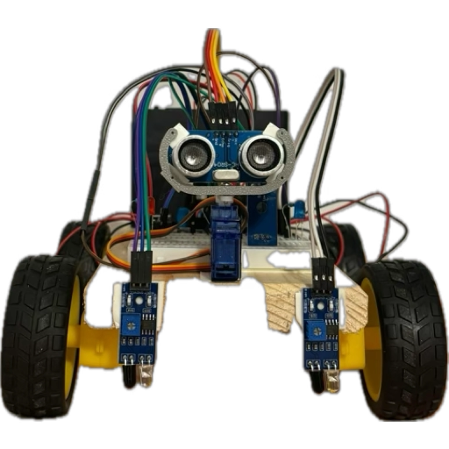
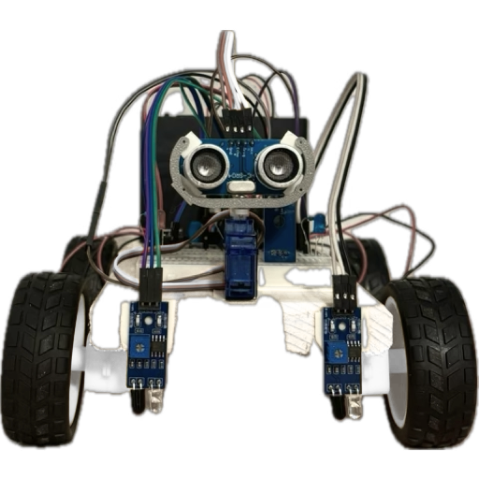
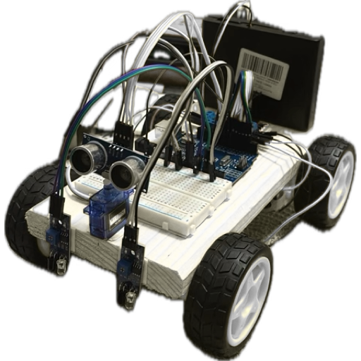
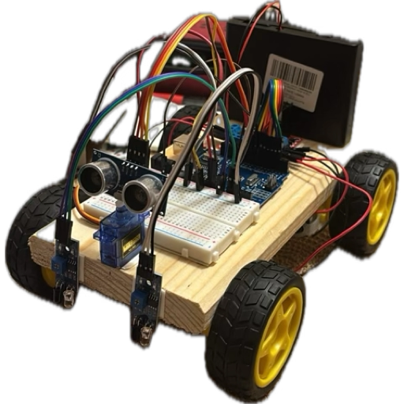
MEET BOSTĂNEL

Slide 4
A line follower robot is designed to follow a specific path, typically represented by a black line on a white surface or a white line on a black surface, thanks to an IR sensor. Additionally, using an ultrasonic sensor, Bostanel can avoid obstacles .
SIMPLE YET EFFECTIVE

Slide 5
COMPONENTS
2 MH- B IR (INFRARED)
SENSORS
H BRIDGE L298N
MOTOR DRIVER & 4 DC MOTORS
3 RGB LED DIODES
for controlling motors & movement
for signaling the state of the robot regarding the path
for line detection
1 HC-SR04 ULTRASONIC SENSOR
1 SG90 SERVOMOTOR
WIRES
for ensuring a broad angle of
distance deduction
for establishing connection between components
for computing the distance to objects

Slide 6
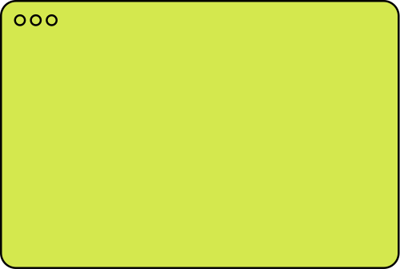
DEEPER DIVE - SENSORS
ULTRASONIC SENSOR
INFRARED SENSOR
-emits high-frequency sound pulses
-the emitter shines infrared light onto the floor
-when the sound reaches an obstacle, it bounces back as an echo
-the sensor detects the of the reflected IR light
-the time for the echo to return is then measured
-the white surface reflects most IR light back to the sensor (LOW signal)
-the black line absorbs most IR light, reflecting very little (HIGH signal)
-the microcontroller calculates the distance to the object and acts accordingly

Slide 7
MECHANISM-FEEDBACK CONTROL
SENSING
The sensors constantly scan the ground and environment to assure the robot is placed on the line (usually dark color), off the line(usually light color) or in a close proximity of an obstacle
PROCESSING
The data harvested through the sensors reaches Bostanel’s “brain”, the microcontroller, that makes a decision
ACTUATING
The microcontroller commands the wheels to either speed up, slow down, swerve left/right to adjust direction

Slide 8
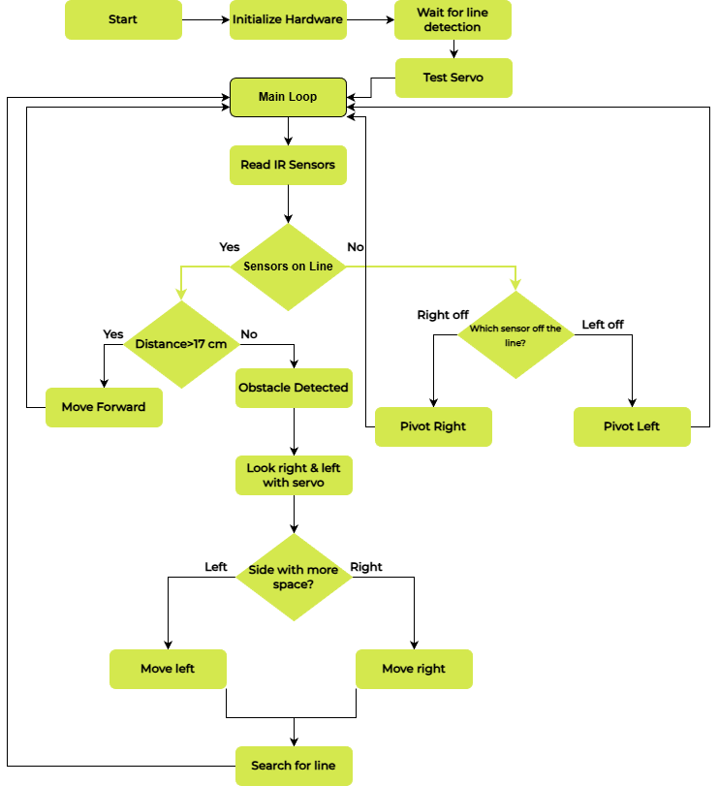
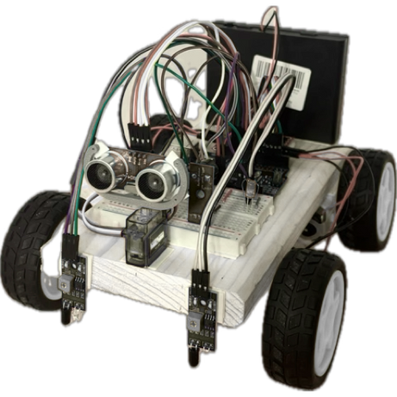
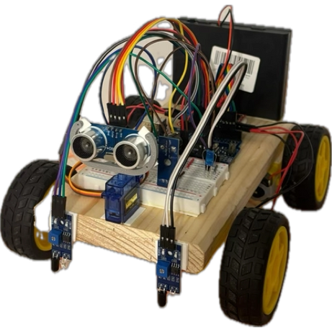
GUIDING
FLOWCHART

Slide 9
USAGE - LARGER SCALE
INDUSTRY & WAREHOUSES
EDUCATION & STEM
Developed into a more advanced form, an AVG (Automated Guided Vehicle), it is used to transport parts/ components between production lines
Visual tool heavily used, great for teaching coding, electronics and the basic principles of robotics

Slide 10
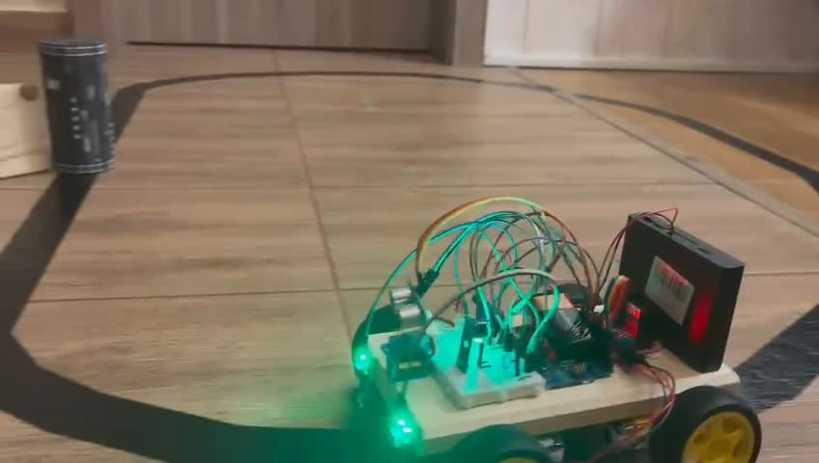
RECORDED DEMO

Slide 11

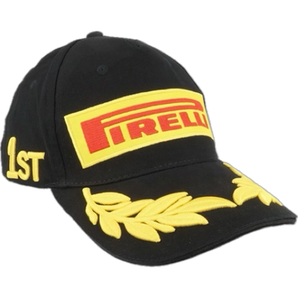
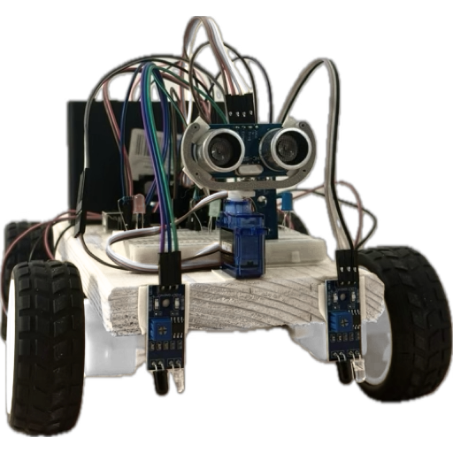
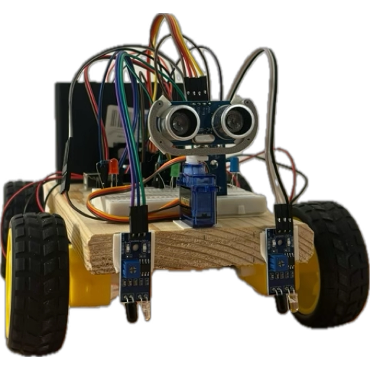
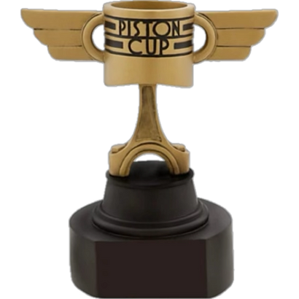
THANK YOU
QUESTIONS?

